Slide 1
x86 Intel Architecture
Instructor: john ortiz
Lecturer III utsa
stego@satx.rr.com
CS 3843 computer organization

Slide 2
Basic Execution Environment
How the processor executes instructions and manipulates data
Memory Model
Address Space
General Purpose Data Registers
Segment Registers
Flags Register
Instruction Pointer

Slide 3
Basic Execution Environment
3 Modes of Operation for IA-32 Architecture
Protected Mode
Real-Address Mode
System Management Mode
Each Operating Mode determines which instructions and architectural features are accessible

Slide 4
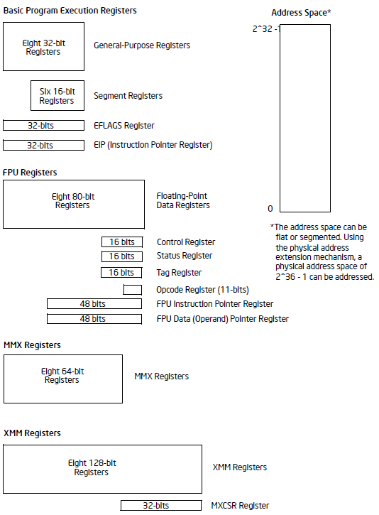
Basic Execution Environment

Slide 5
Memory Models
Address Space
Linear Address up to 4 GB
Physical Address Space up to 64 GB
Real Address Mode Memory Model
Memory model for the Intel 8086
Uses specific implementation of segmented memory
Array of segments up to 64 Kbytes each
Linear address space is 1 MB ( 2²⁰ )
Flat Memory Model
Memory is a single contiguous address space
Linear Address Range 0 to 2³² – 1 (0x0 - 0xFFFFFFFF)

Slide 6
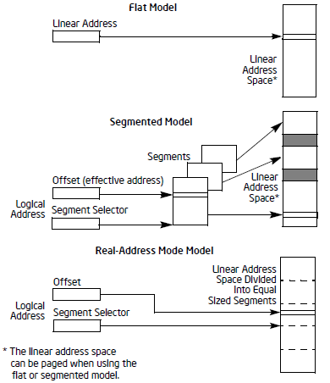
Memory Models
Segmented Memory Model
Memory is a group of independent address spaces
Code, data, stacks are generally in different segments
Segment selector identifies the segment and an offset identifies the byte within the segment
16383 segments
Each up to 2³² bytes
Using segments can prevent the stack from growing into code

Slide 7
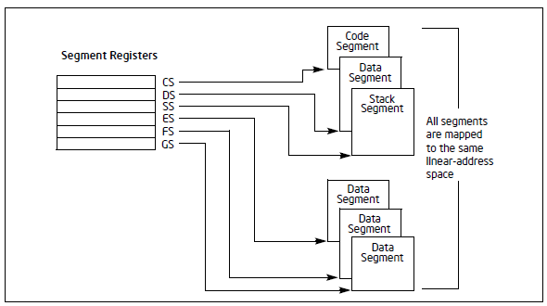
Segmented Memory Model
Each segment can point to overlapping (or not) virtual memory

Slide 8
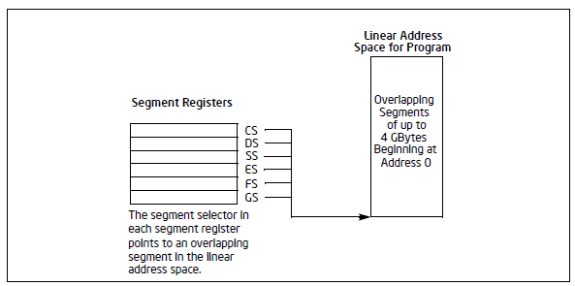
Memory Models
Implementation on Windows sets most segments to point to the same linear address space
Effectively a flat memory model with a linear address space of 4GB
ONE EXCEPTION: FS is used to point to different memory for the Process Environment Block

Slide 9
Paging and Virtual Memory
Physical memory is the hardware, the memory you buy and put into the machine
Virtual memory allows every 32-bit process to seemingly have 4 GB of memory
Virtual addresses are mapped to physical memory in 4K pages (on a 32-bit system)
Only physical memory required by a process is actually used
When more memory is needed than physical memory available, the physical memory can be swapped to disk

Slide 10
Paging and Virtual Memory
Suppose I have 32K (yes, kilo) bytes of physical memory
How many 4K pages are available?

Slide 11
Paging and Virtual Memory
Suppose I have 32K (yes, kilo) bytes of physical memory
How many 4K pages are available?
8 --- > 8 * 4K = 32K
Suppose I have 16 address lines
How many possible addresses can I access?

Slide 12
Paging and Virtual Memory
Suppose I have 32K (yes, kilo) bytes of physical memory
How many 4K pages are available?
8 --- > 8 * 4K = 32K
Suppose I have 16 address lines
How many possible addresses can I access?
65536 == 64K == log₂⁻¹(16) == 2¹⁶

Slide 13
Paging and Virtual Memory
One processes needs 20K, so it will have 5 pages mapped directly to physical memory
Not necessarily contiguously
It “thinks” it has a full 64K available
For our fictitious 16-bit address line
0x0 to 0xFFFF
So maybe one address used may be 0x0000
Does NOT have to be mapped to physical address 0x0000!!
Another address may be 0xc000
0xc000 > 32K (0x7FFFF), but can be mapped to any unused physical address within the 32K range
Mapping is fast, done by hardware & software
Level 1 and level 2 caches help

Slide 14
Paging and Virtual Memory
Virtual Memory
Physical Memory
Process #1: 0x0000
0x0000
Process #1: 0x1000
0x1000
Process #1: 0x7000
0x2000
Process #1: 0xc000
0x3000
Process #1: 0xf000
0x4000
0x5000
Process #2: 0x3000
0x6000
Process #2: 0x4000
0x7000
Process #2: 0xf000
If a third process needs some memory, then a page (or more) will be saved to disk, (in the paging file) and that process will get the physical RAM for its time slot

Slide 15
Paging and Virtual Memory
For the programmer, every 32-bit process “thinks” it has a full 4 GB of address space
Regardless of physical RAM availability
Regardless of physical RAM address
One process cannot simply access the memory of another process
0x10000 on one process is mapped to different physical RAM than 0x10000 in another process
Must use Interprocess communication

Slide 16
Paging and Virtual Memory
How many 4k pages in 32 bits?
You should be able to do this quickly on paper

Slide 17
Paging and Virtual Memory
How many 4k pages in 32 bits?
You should be able to do this quickly on paper
4K = 2¹²
2³² / 2¹² = 2²⁰ = 1 M = 0x 100000 = 1048576

Slide 18
Memory Classifications
Applies to both Windows and Linux though actual addresses will be different
Kernel Memory
Reserved for kernel usage
Program Memory
Includes code and data
Constant values such as strings
Multimedia
Debugging tables
Global/static variables
Heap Memory
Stack Memory
Unassigned

Slide 19
Registers
Eight general purpose registers ( 32 bits )
eax, ebx, ecx, edx, esi, edi, ebp, esp
Six segment registers ( 16 bits )
cs, ds, ss, es, fs, gs
One flags register
eflags
Reports the status of the program being executed and allowed limited control of the processor
One Instruction Pointer
eip
Points to next instruction to be executed
*Note: “e” stands for extended (i.e. 32 bits)
“eax” is extended ax register

Slide 20
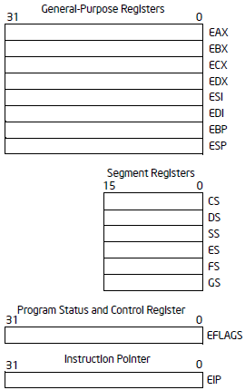
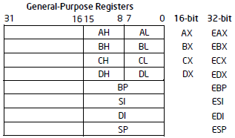
Registers
No 8-bit versions

Slide 21
General Purpose Registers
EAX - Extended Accumulator
Accumulator for operands and results data
EBX - Extended Base register
Pointer to data in the DS segment
ECX - Extended Count register
Counter for string and loop operations
EDX - Extended Data register
I/O Pointer, general data

Slide 22
General Purpose Registers
ESI - Extended Source Index
Pointer to data in the DS segment
Source pointer for string operations
EDI - Extended Destination Index
Pointer to data in the DS segment
Destination pointer for string operations
ESP - Extended Stack Pointer
Stack pointer (in the stack segment)
EBP - Extended Base Pointer
Pointer to data on the stack (in the stack segment)

Slide 23
Segment Registers
CS - Code Segment
Pointer to executable code
eip is the offset into the code segment
SS - Stack Segment
Pointer to the stack
stack pointer is the offset in the stack segment
DS - Data Segment
Pointer to data in the DS segment
ES - Extra Segments for data
FS - Extra Segment for data (386 and above)
GS - Extra Segment for data (386 and above)

Slide 24
Segment Registers
In Windows, except for FS, all segment registers point to the same place in memory
Linux also uses a flat memory model and paging
Also, it is possible to do a segment override on a per instruction basis
Tell a particular instruction to use a different segment

Slide 25
Instruction Pointer
EIP points to the next machine code instruction to be executed
x86 is a CISC architecture
Complex instruction set
Many instructions, different sizes
RISC is Reduced Instruction Set
Automatically incremented when each instruction is executed
The amount incremented depends on the instruction and its arguments

Slide 26
Instruction Pointer
Cannot be accessed directly by software
There is no “mov eip, eax” type of instruction
Can be “loaded” by jump, call, and branch instructions
Could load eip as follows:
push eax
return
But can also call eax – so why do the above???

Slide 27
Instruction Pointer
Cannot be accessed directly by software
There is no “mov eip, eax” type of instruction
Can be “loaded” by jump, call, and branch instructions
Could load eip as follows:
push eax
return
But can also call eax – so why do the above???
Malware takes advantage of that!
Can be read as follows:
call label
label: pop eax
; eax now has the address of label
eip is incremented immediately after reading the instruction
We’ll see why that is important later

Slide 28
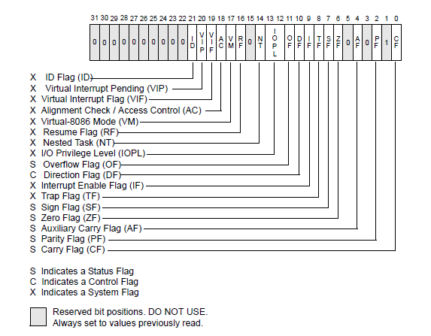
Flags Register
EFLAGS keeps status flags, control flags, and system flags

Slide 29
Flags Register
NOTE: for ALL Flag Register examples, using 8 bits
CF – Carry Flag
Set if arithmetic operation generates a carry or borrow out of the MSB, cleared otherwise
MSB might be bit 7, bit 15, bit 31 depending on operation size
It is overflow for unsigned arithmetic
0xFF + 1 = 0x100 --- sets carry
0x05 – 0x06 = 0xFF --- also sets carry (i.e. generates borrow)
0 0000 0101 + 1 1111 1010 = 1 1111 1111
0x05 – 0x04 = 0x01 does NOT set carry
0 0000 0101 + 1 1111 1100 = 0 0000 0001
All logical operations clear the carry flag
ZF – Zero Flag
Set if result of operation is zero, cleared otherwise
Set by add/sub and logical operations

Slide 30
Flags Register
SF – Sign Flag
Set equal to the MSB of the result
MSB may be at bit 7, 15, or 31 depending on size of operation
1 indicates a negative result
0111 1111 + 1 = 1000 0000 --- > sign flag is set
If result is 128 to 255, sign flag set (8 bits ONLY)
OF – Overflow Flag
Set if the result overflows into the sign bit
Too large of a positive number
Too small of a negative number
Overflow for signed arithmetic
Set when
Two positive operands generate a negative sum
Two negative operands generate a positive sum

Slide 31
Flags Register
char x = 0x7f; (x = 127)
Largest possible positive number for 8 bits
x = x + 1; now x == 0x80 (128)
0x80 is -128 in signed arithmetic: 127 + 1 = -128???
OF flag is set to indicate the overflow
127 + 1 OR -128 – 1 [-128 + -1] set overflow
Overflow always cleared if two addends have different signs
Compiler will set the assembly code to act on it if it’s a signed value
Unsigned branch instructions do NOT act on it
Signed branch instructions take its value into account

Slide 32
Flags Register
PF – Parity Flag
Set if least significant byte of the result has an even number of bits, cleared otherwise
AF – Auxiliary Carry Flag
Set if operation generates a carry out of bit 3, cleared otherwise
Used for Binary Coded Decimal (BCD) arithmetic
In BCD, 9 + 1 = 0, carry the 1
Each nibble has one decimal digit, 0 to 9
So 38 + 1 = 39 --- > 0011 1000 + 1 = 0011 1001
39 + 1 = 40 --- > 0011 1001 + 1 = 0100 0000, NOT 0011 1010

Slide 33
Flags Register
DF – Direction Flag
Applies to string instructions only
movs, cmps, scas, lods, stos
Determines if esi/edi are incremented or decremented
Size of operation determines amount: 1, 2, or 4
TF – Trap Flag
Used for single-stepping the processor
Windbg makes use of this flag
IF – Interrupt Enable Flag
Enables/disables interrupts
IOPL – I/O Privilege Level
Prevents users from executing privileged instructions
Rest of the flags, you can read about on your own

Slide 34
Endian
Big Endian
Motorola based products use Big Endian
MSB (most significant byte) is in lowest memory address
Easy to read when looking at memory
0x400000: 01 23 45 67
Value = 0x1234567
Little Endian
Intel products use little endian
MSB is in highest address
0x400000: 01 23 45 67
Value is 0x67452301

Slide 35
Alignment
Generally data is aligned to its inherent size
DWORD (32 bits, 4 bytes) is aligned to a 4-byte boundary
0x0000, 0x0004, 0x0008, etc
WORD (16 bits, 2 bytes) is aligned to a 2-byte boundary
0x0000, 0x0002, 0x0004, etc
In binary, a 2-byte boundary will always end in 10₂, i.e. least significant bit is zero
A 4-byte boundary in 100₂, i.e. least significant 2 bits are zero
Misaligned data is less efficient, but possible

Slide 36
The Stack
The stack is memory set aside to be used as temporary storage during function calls
Typically, it’s used for …
1. ???
2. ???
3. ???
4. ???
5. ???

Slide 37
The Stack
The stack is memory set aside to be used as temporary storage during function calls
Typically, it’s used for …
1. Local Variables
char x; int y; etc.
2. ???
3. ???
4. ???
5. ???

Slide 38
The Stack
The stack is memory set aside to be used as temporary storage during function calls
Typically, it’s used for …
1. Local Variables
char x; int y; etc.
2. Function parameters
Func (param 1, param 2, param 3 … )
The parameters are pushed onto the stack in reverse order
param #3, param #2, param #1
3. ???
4. ???
5. ???

Slide 39
The Stack
The stack is memory set aside to be used as temporary storage during function calls
Typically, it’s used for …
1. Local Variables
char x; int y; etc.
2. Function parameters
Func (param 1, param 2, param 3 … )
The parameters are pushed onto the stack in reverse order
param #3, param #2, param #1
3. Return Address
When a function is called, the address of the next instruction is pushed onto the stack after the parameters
4. ???
5. ???

Slide 40
The Stack
The stack is memory set aside to be used as temporary storage during function calls
Typically, it’s used for …
1. Local Variables
char x; int y; etc.
2. Function parameters
Func (param 1, param 2, param 3 … )
The parameters are pushed onto the stack in reverse order
param #3, param #2, param #1
3. Return Address
When a function is called, the address of the next instruction is pushed onto the stack after the parameters
4. EBP – this is often pushed onto the stack during a function call to set up the stack frame
5. ???

Slide 41
The Stack
The stack is memory set aside to be used as temporary storage during function calls
Typically, it’s used for …
1. Local Variables
char x; int y; etc.
2. Function parameters
Func (param 1, param 2, param 3 … )
The parameters are pushed onto the stack in reverse order
param #3, param #2, param #1
3. Return Address
When a function is called, the address of the next instruction is pushed onto the stack after the parameters
4. EBP – this is often pushed onto the stack during a function call to set up the stack frame
5. Temp storage for registers

Slide 42
Stack Operations
The following instructions are used in conjunction with stack operations
push register
pop register
call function
retn
Anyone want to explain any of these
BEFORE looking to the next slide :/

Slide 43
Questions & Comments

Slide 44
References
https://msdn.microsoft.com/en-us/library/windows/desktop/aa365574(v=vs.85).aspx
Intel Reference Manuals
https://en.wikipedia.org/wiki/X86_memory_segmentation

